Slide 1
Scattering assisted quantitative imaging
Rakesh Kumar Singh
Home | Optics Lab | Information photonics and optical metrology | Varanasi
Department of Physics, Indian Institute of Technology (Banaras Hindu University), Varanasi, Uttar Pradesh, 221005, India
krakeshsingh.phy@iitbhu.ac.in
krakeshsingh@gmail.com
UEC-SAARC Symposium on Emerging Technologies; 13-14 December 2022

Slide 2
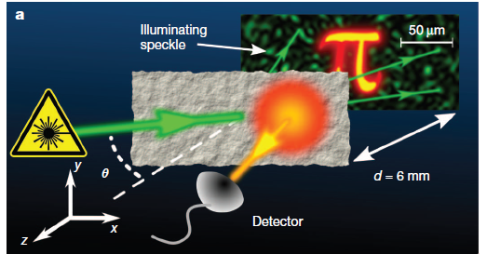
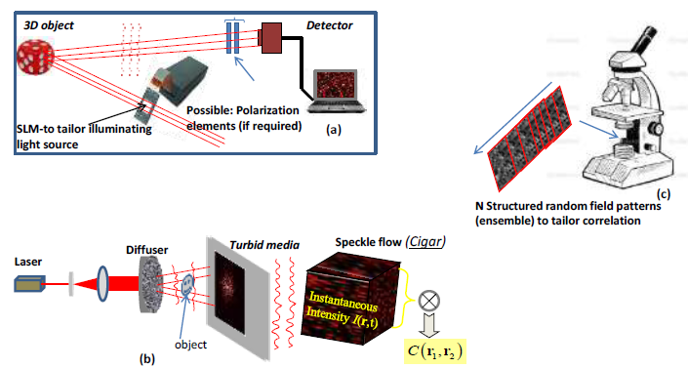
Optics with random light

Slide 3

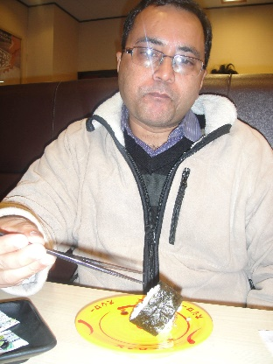
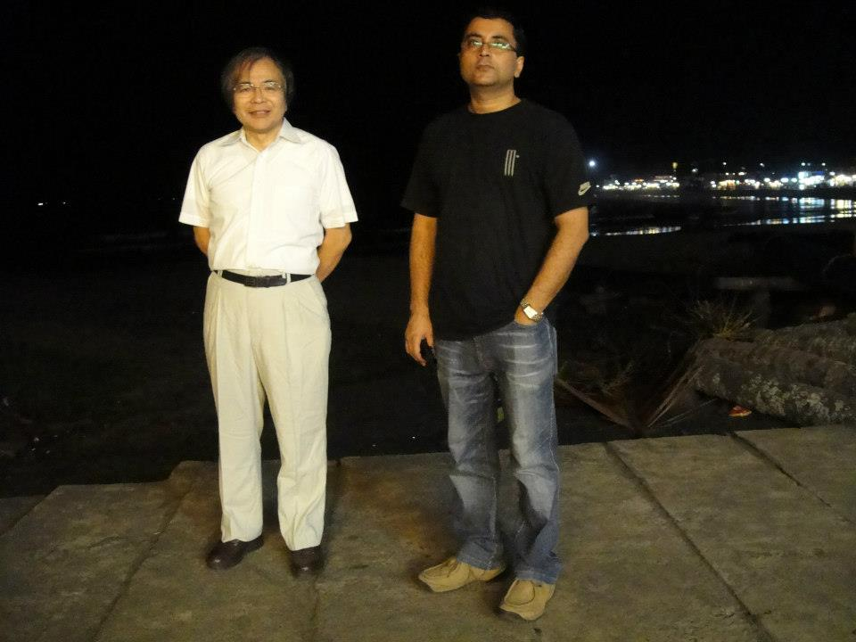
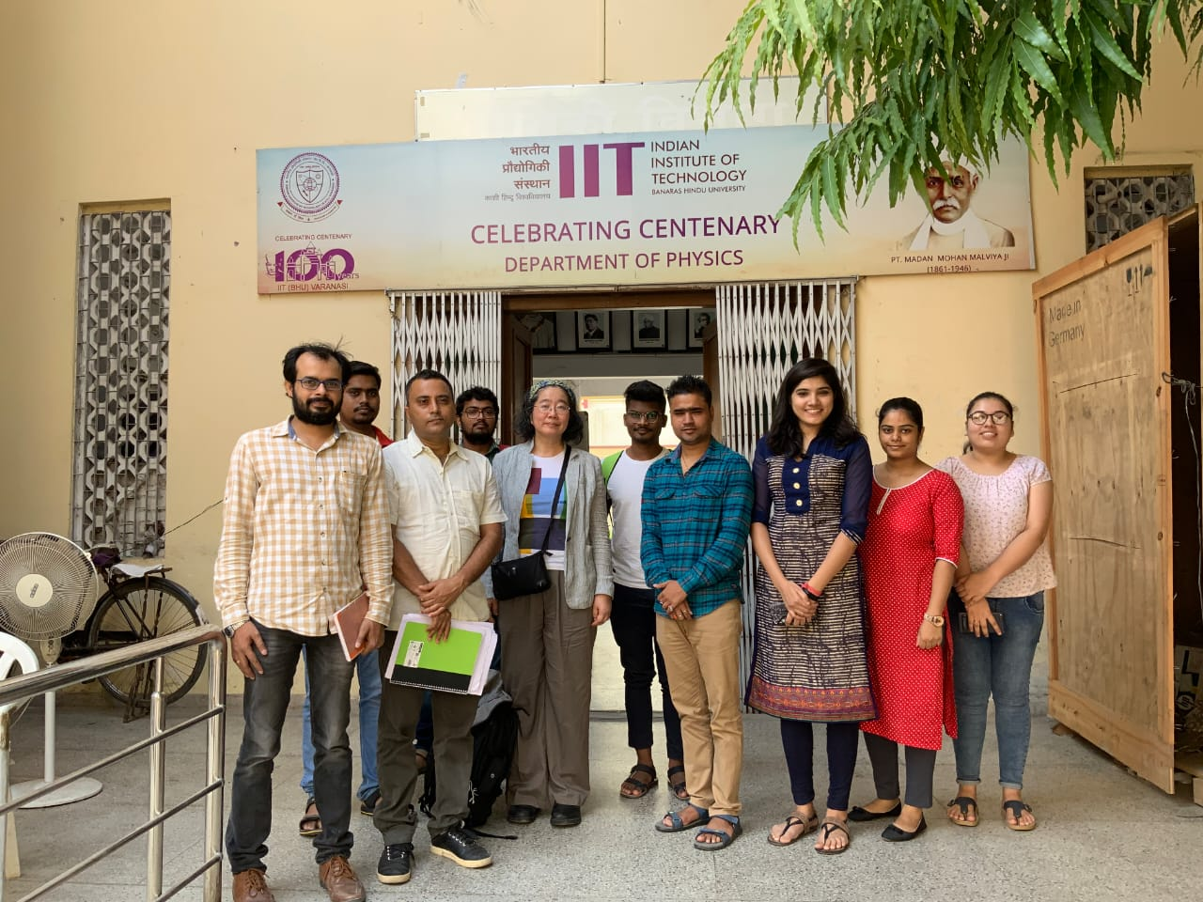
Our association with the UEC
JSPS fellow and postdoc during August 2009- October 2011
Visiting researcher to the UEC in December 2015
Our recent MoU between the UEC & IIT (BHU)
Prof. Takeda’ visit to Trivandrum
Prof. Takeda’ visit to Varanasi

Slide 4

Outline
Background
Optical Imaging
Imaging through scattering medium
Different methods
Correlation holography
Holography with HBT
Randomness assisted imaging
Single pixel detection
STICH: new correlation holography
Quantum inspired imaging: Ghost holography
Conclusion

Slide 5
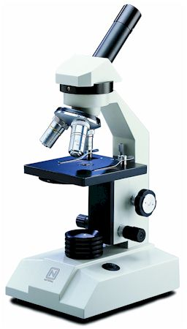
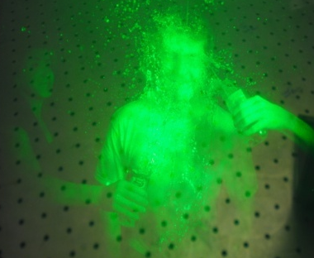
Optical Imaging
Replica at imaging plane
Microscopy: improvement in resolution possible by tailored illumination
Holography: Provides 3D complex field reconstruction
Optical imaging through randomness ?
2f
2f
Imaging lens

Slide 6
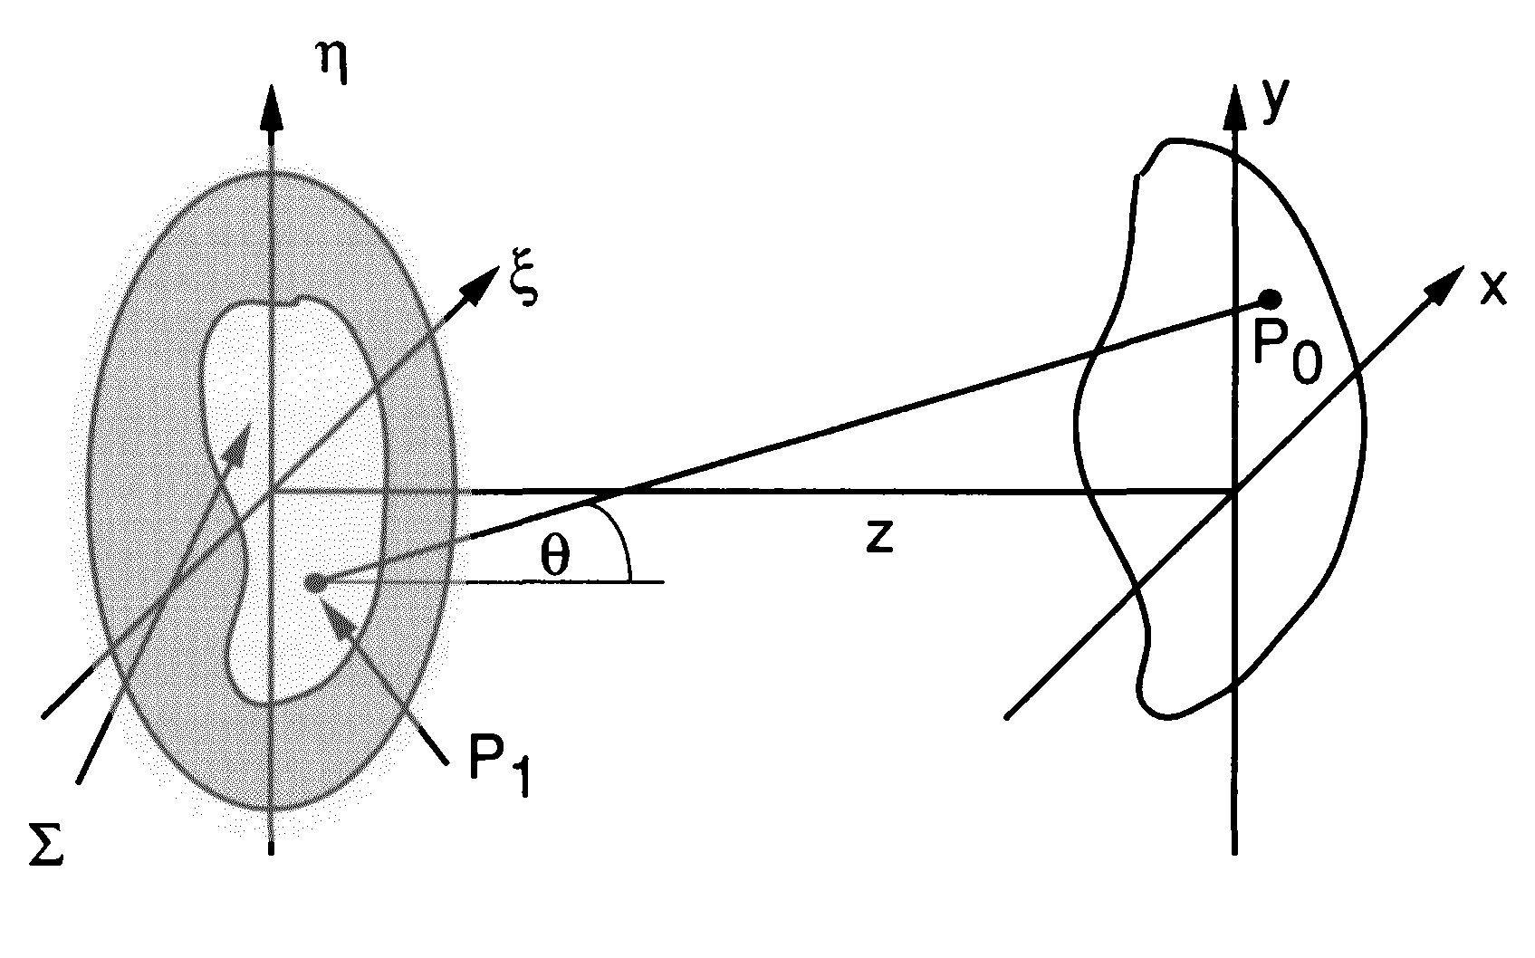
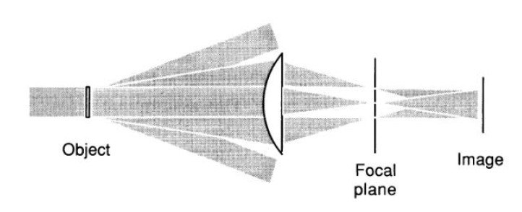


Imaging: Basic principle
Resolution: is limited by diffraction
J. Goodman, Fourier Optics

Slide 7
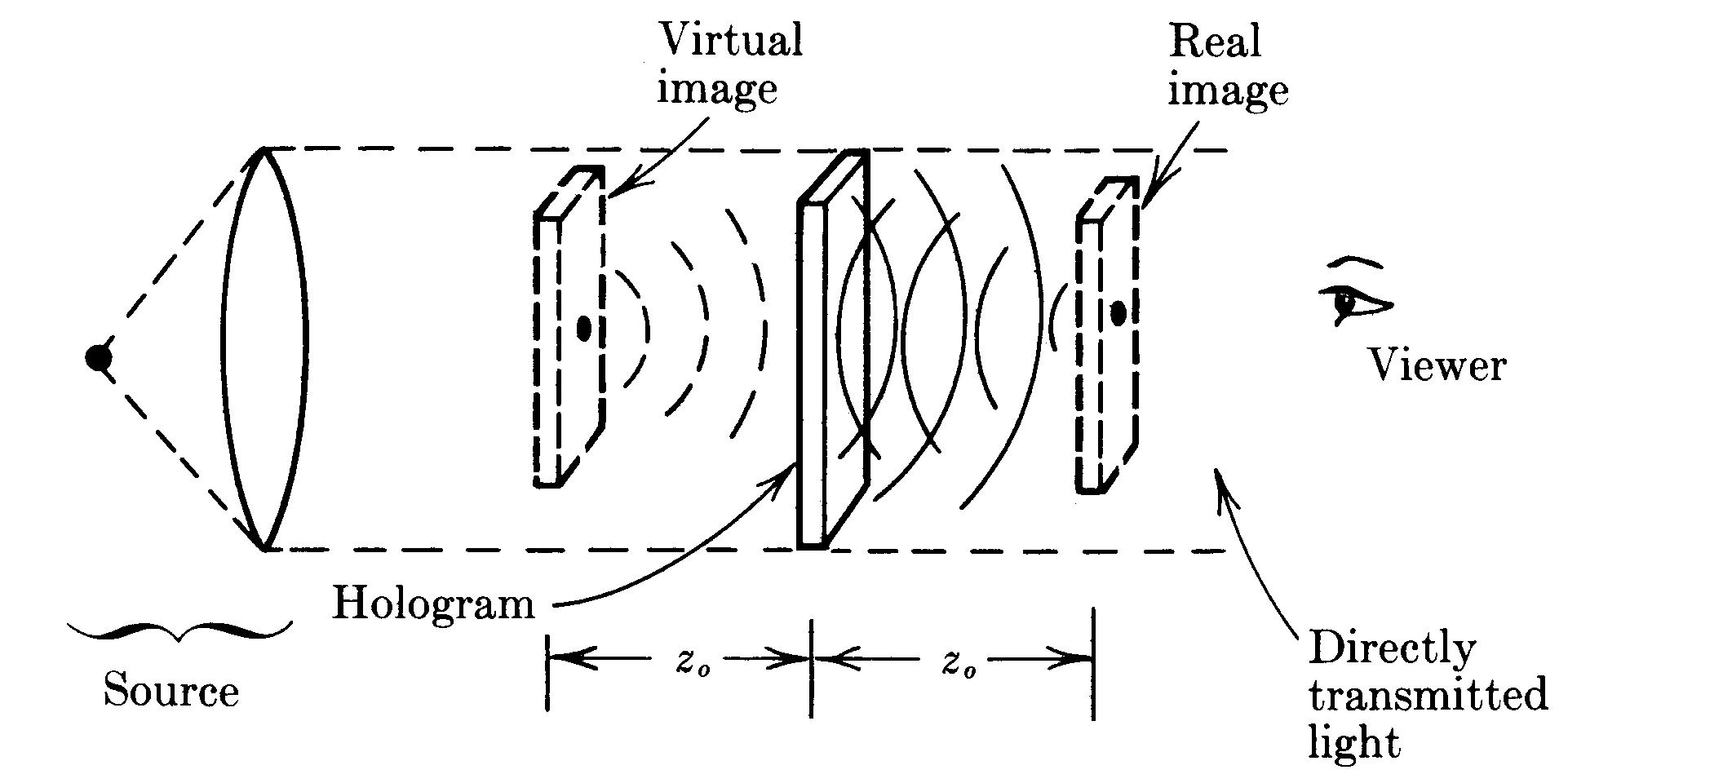
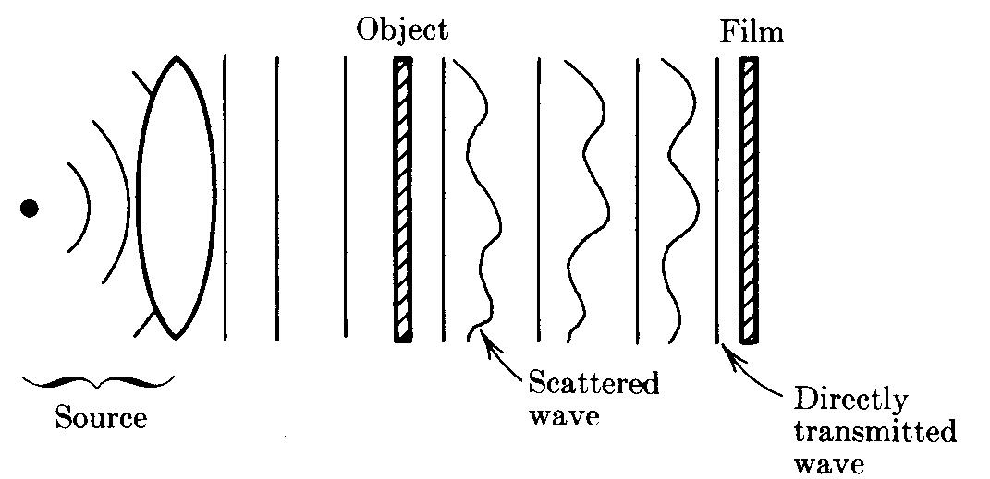
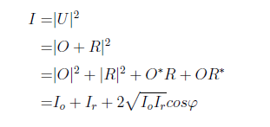
Holography
Gabor’s Holography: In line Holography
Off-axis Holography
Object
Pseudo
Image
J. Goodman, Fourier Optics

Slide 8
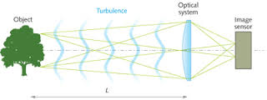
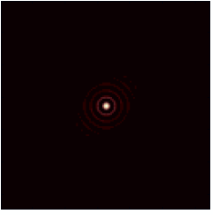
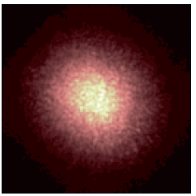
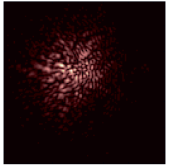
Imaging through scatterer
Atmospheric perturbed PSF observed at the focus of a large ground based telescope. Left to right –ideal PSF, long exposure PSF, short exposure PSF
M. Carbillet, New Concepts in imaging: optical and statistical models, EAS 2013

Slide 9
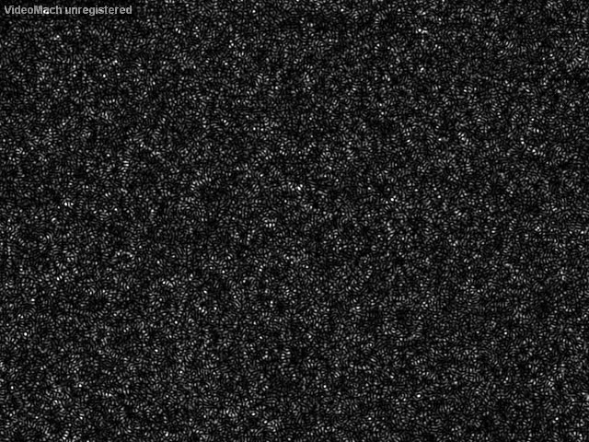
Randomly scattered light: Speckle

Slide 10
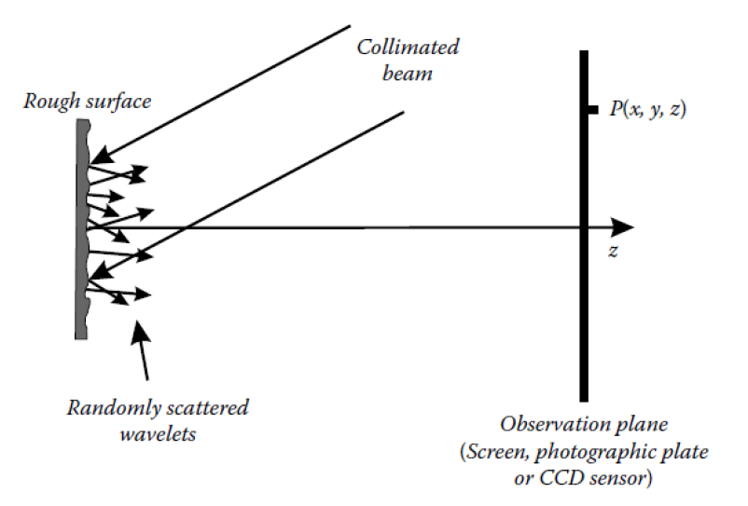
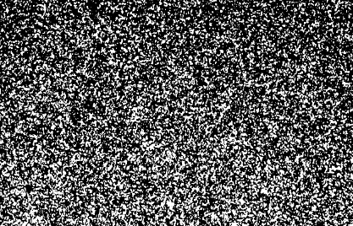
Formation of speckle
Speckle pattern
Physical origin of speckle pattern
Sirohi R.S., Speckle metrology (1993).

Slide 11
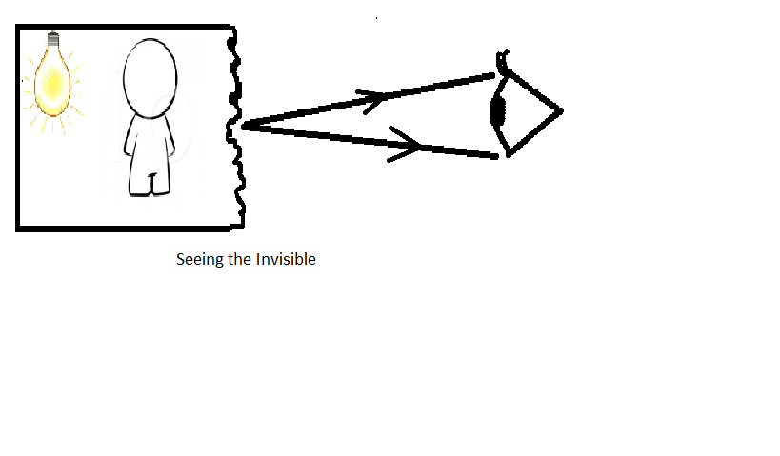
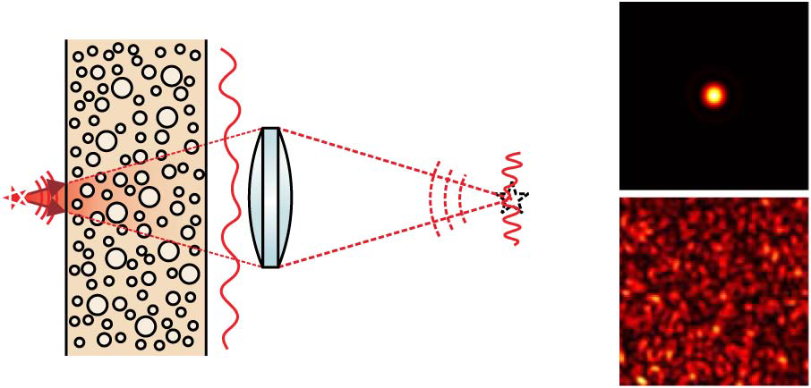
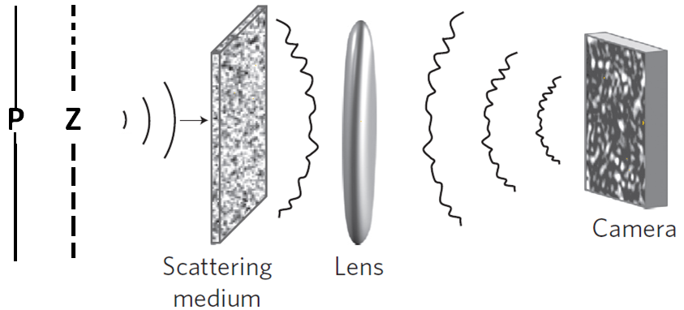
1. Inherent random scattering (No choice)
Limitations:
Conventional imaging technique will not work due to scrambling of wavefront,
Possible solutions:
Adaptive optics
Phase conjugation
Coherence optics
With machine Learning

Slide 12
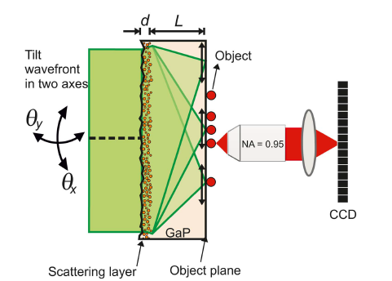
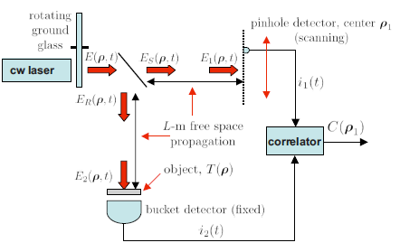
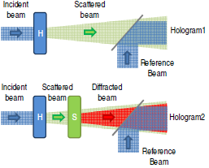
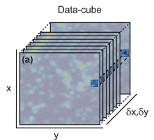
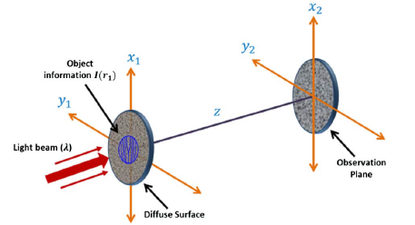
2. Using randomness of the light
Adv. Opt. Photon. 2(2010) 405.
Ghost Imaging & Ghost Diffraction
High resolution holography microscope
Single pixel & computational imaging: 3D imaging,
data security
Customizing speckles : super-resolution & un-conventional imaging
Optica 2 (2015) 424

Slide 13
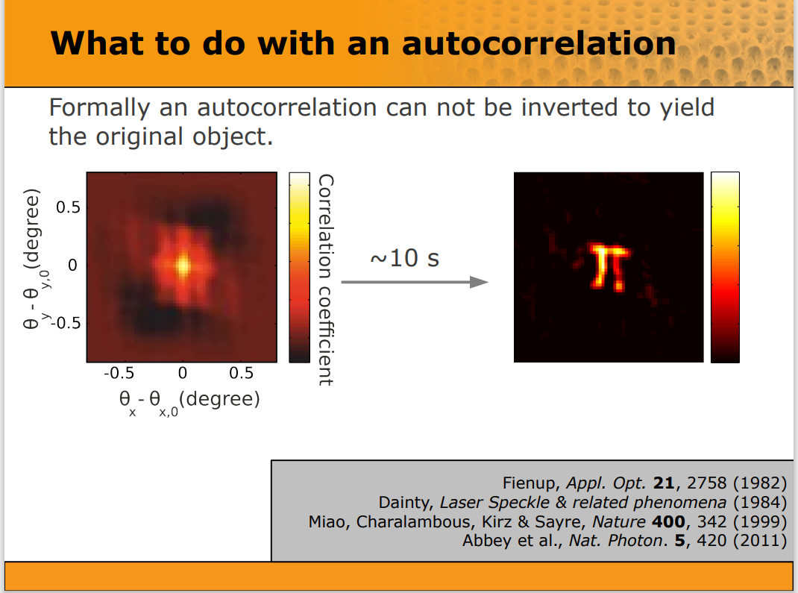
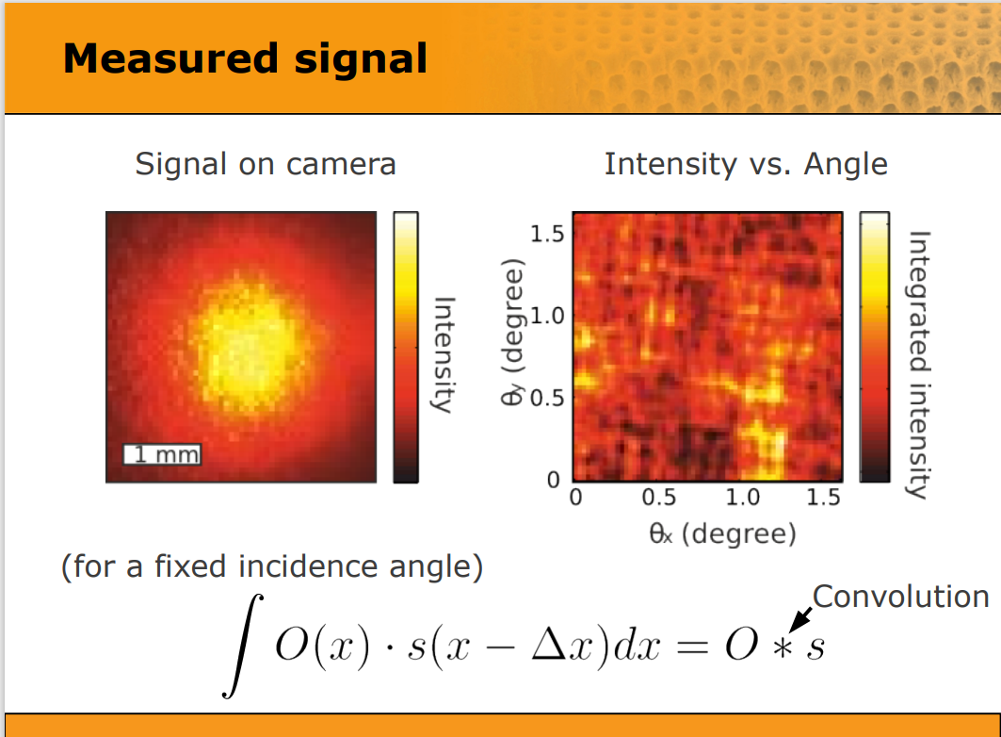
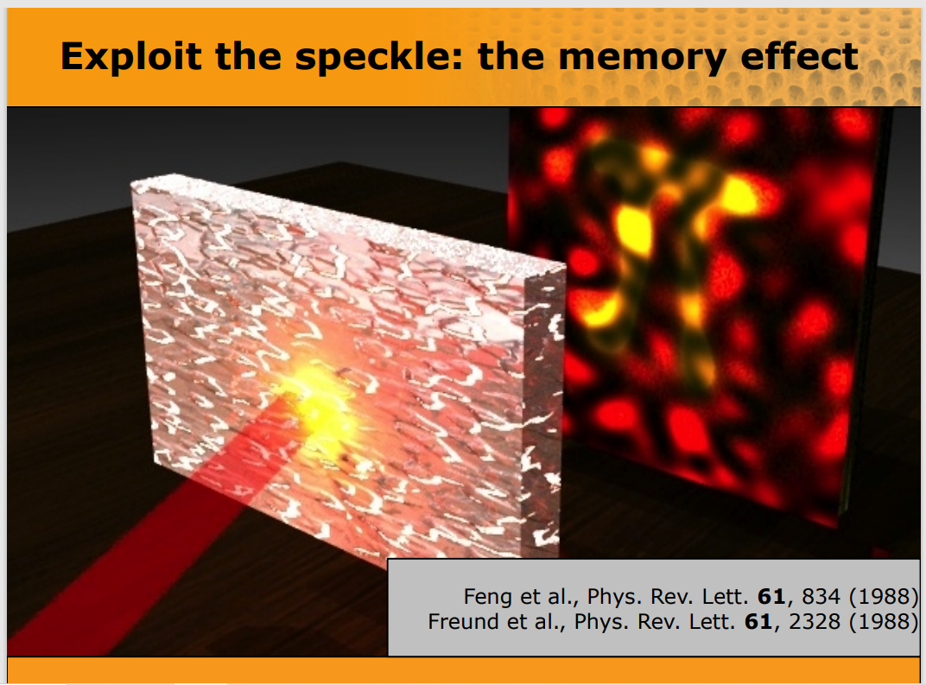
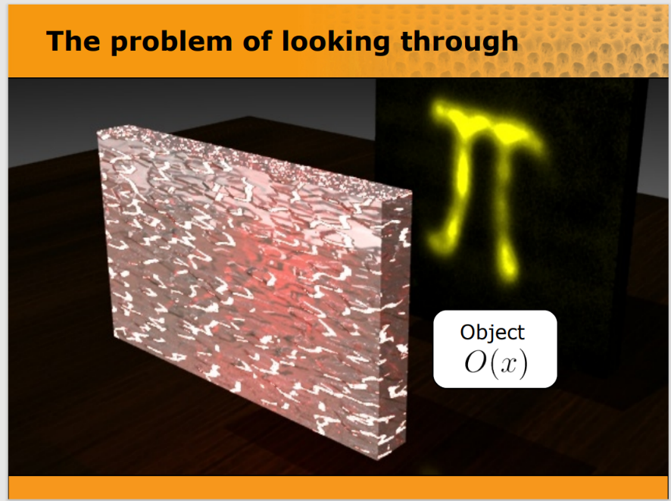
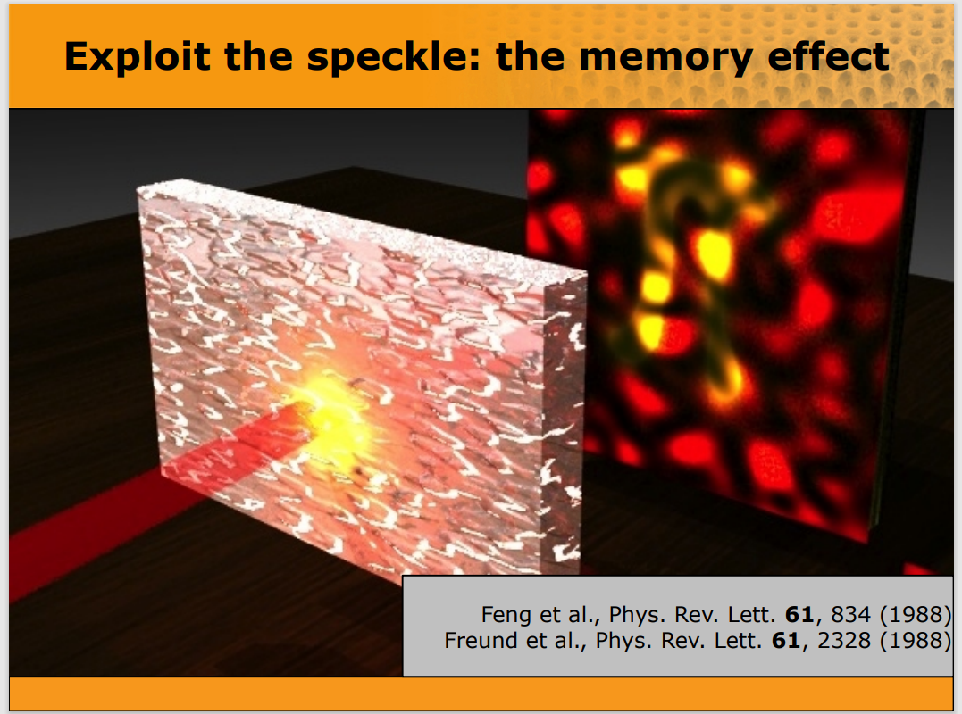
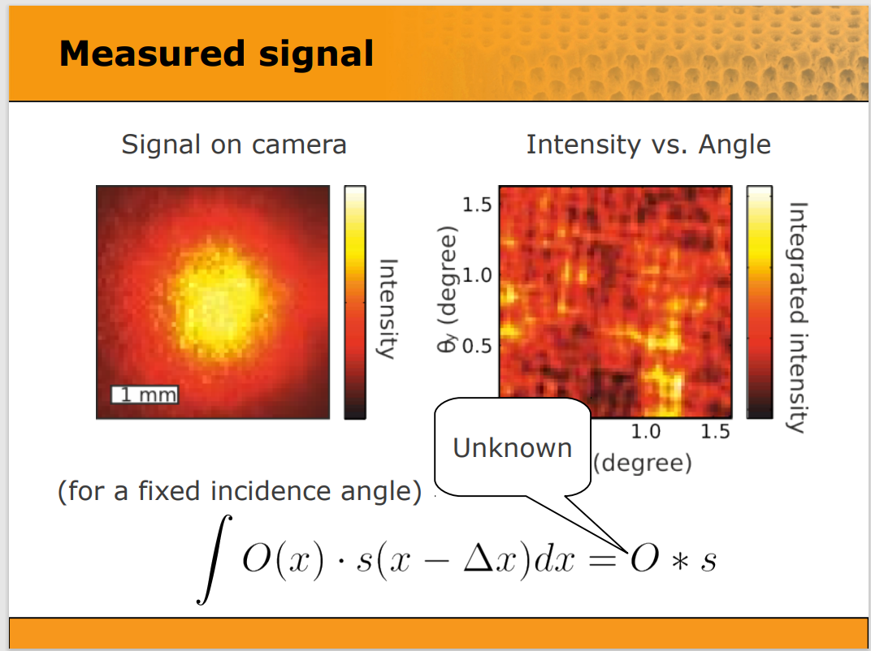

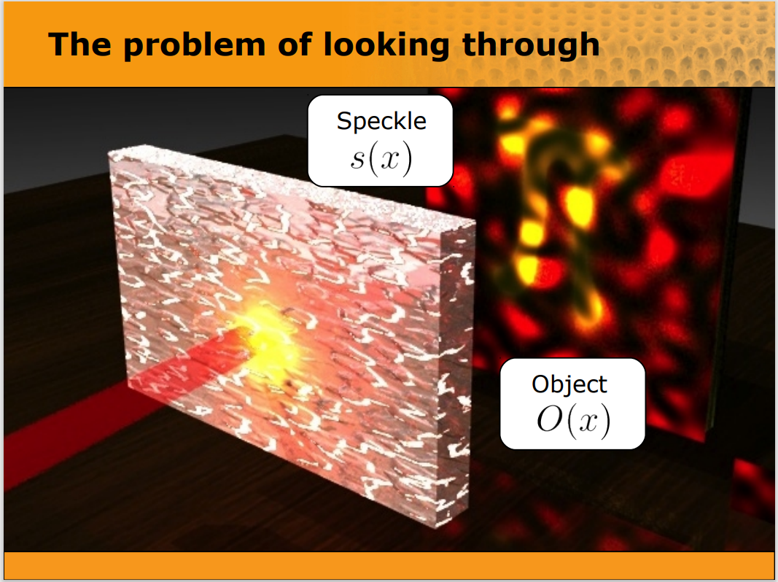
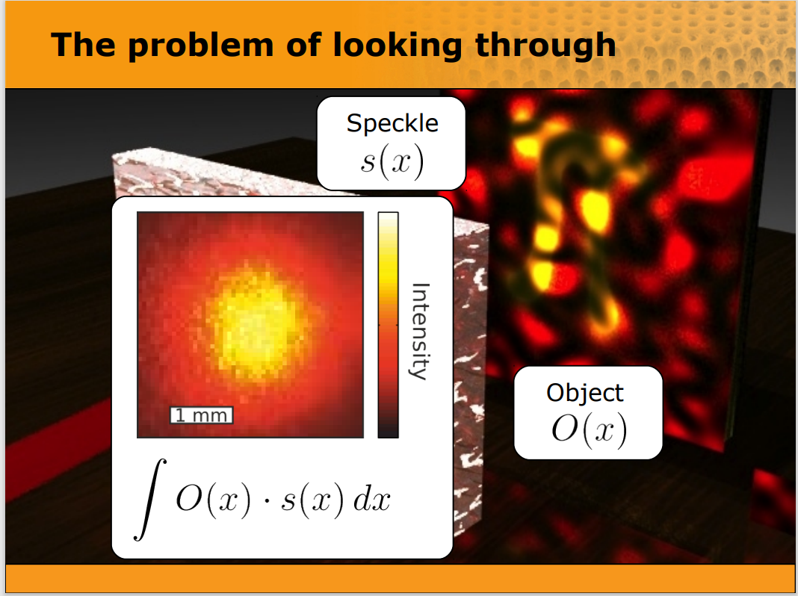
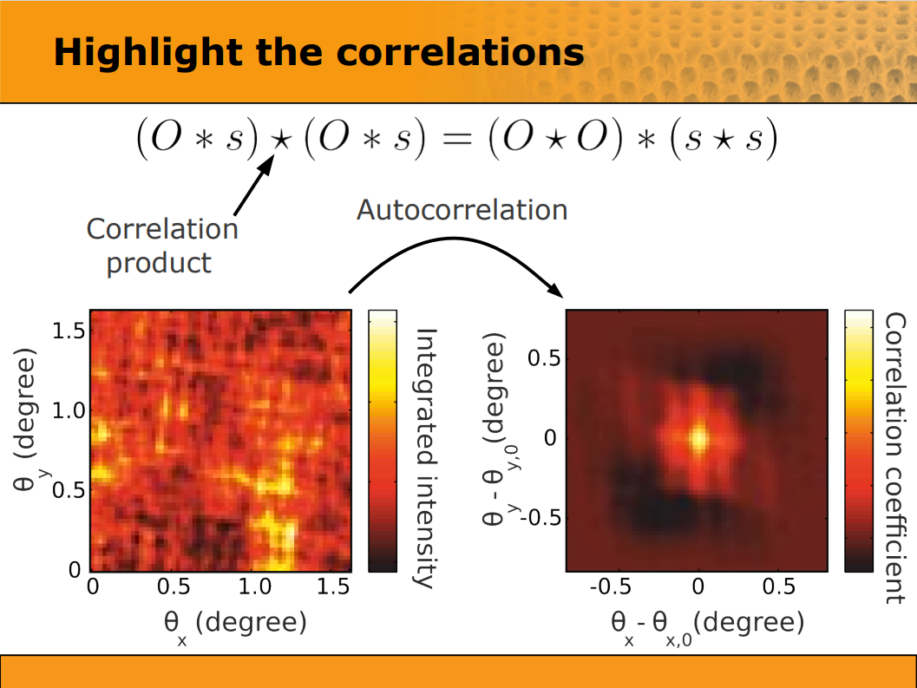
Speckle and Memory effect
Source presentation: J. Bertolotti (1,2), E. G. van Putten (3), C. Blum, Ad. Lagendijk (4), W. L. Vos (1), and A. P. Mosk (1)
Complex Photonic Systems (COPS), MESA+, University of Twente (NL) 2 University of Florence, Dipartimento di Fisica (IT) 3 NanobioPhysics (NBP), MESA+, University of Twente (NL) 4 FOM Institute AMOLF (NL)

Slide 14
Characteristics of the light
Local properties
-Intensity/spectrum
Polarization
Flux/momentum
Non-local properties
-Interference
Coherence Theory: unified theory of the optical field
Correlation function:
Polarization components (i,j =x,y)
average over random ensemble
Ensemble averaging: Temporal or spatial as per requirements

Slide 15
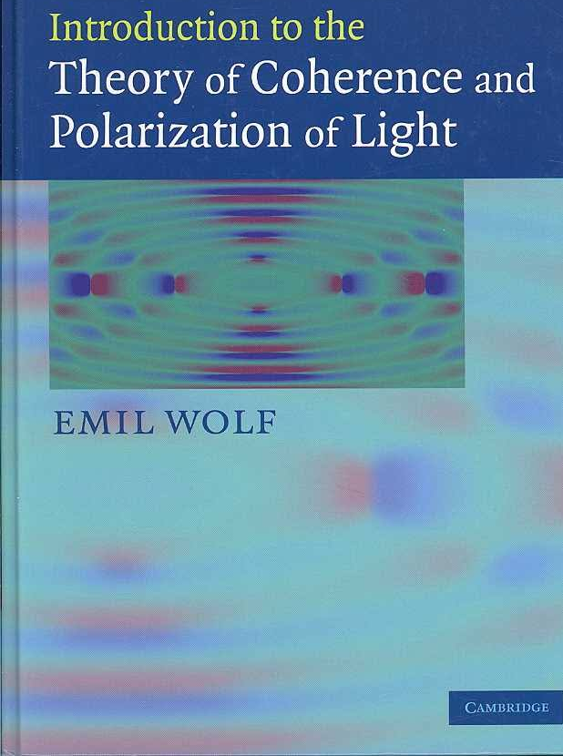

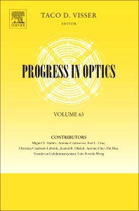
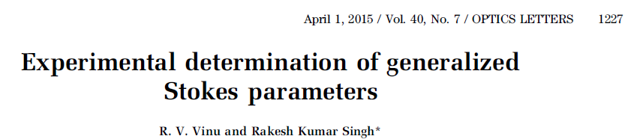
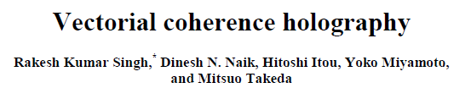
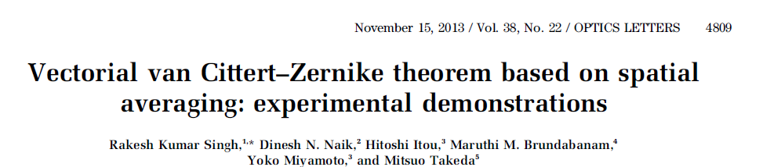
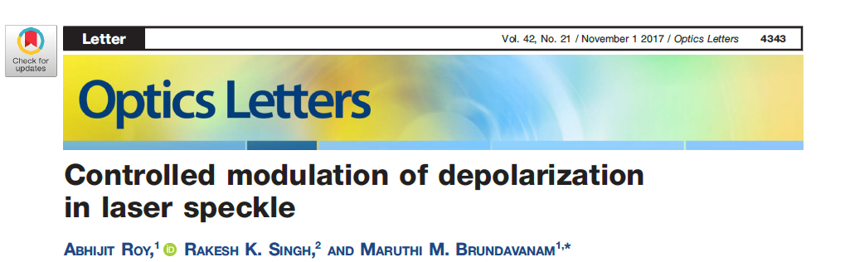
Unified Theory of coherence

Slide 16
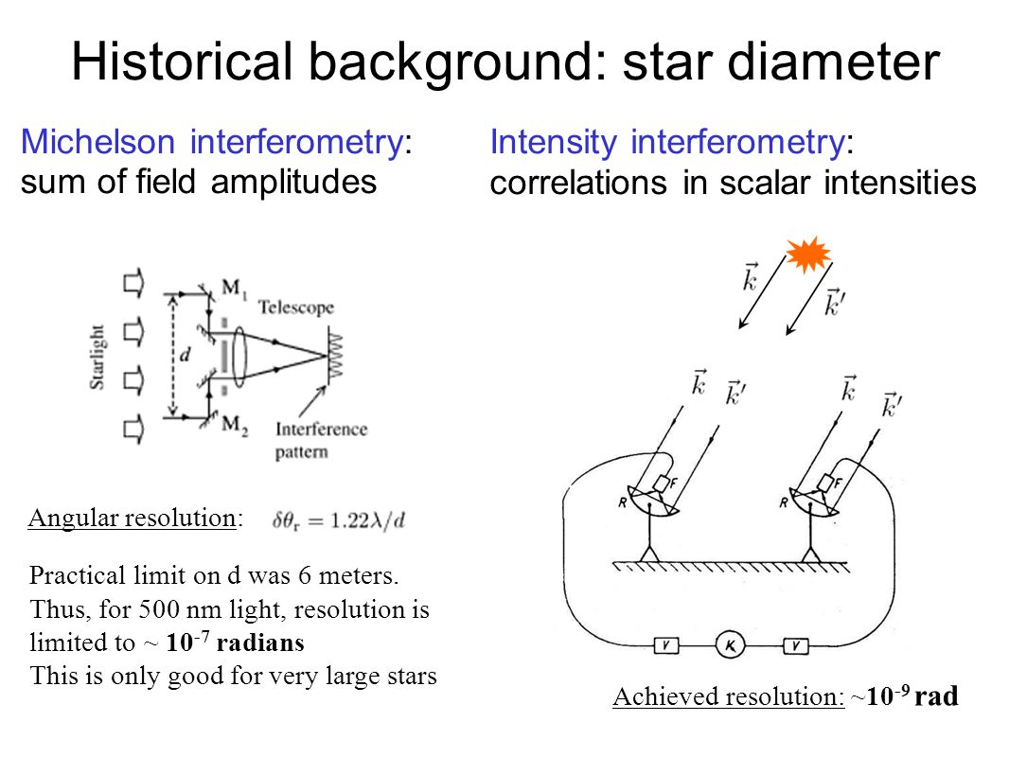
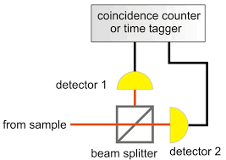
HBT approach
Hanbury Brown-Twiss approach- Nature 177, 27 (1957)
Two point intensity correlation/Intensity interferometer
Highly stable imaging systems with the HBT approach:
Phase shifting holography with HBT method- Opt. Letter 45 (2020) 212; Opt. Express 28 (2020) 8145
HBT with polarized light: Opt. Express 26 (2018) 10801
Opt. Laser in Eng. 148 (2022) 106771

Slide 17
Higher order correlations:

Slide 18
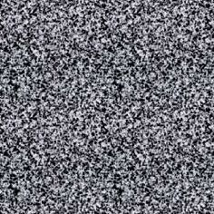
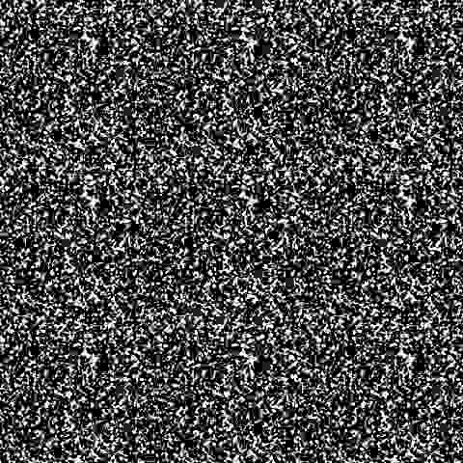
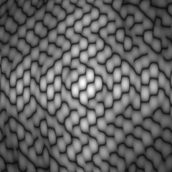
HBT for 3D Holography
Stationary region
L
y
x
z
Hologram
f
f
Pseudo thermal light frozen in time
Instantaneous intensity
D. N. Naik, et al , Opt. Express 19 (2011) 1408

Slide 19
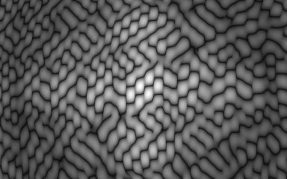

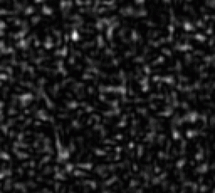
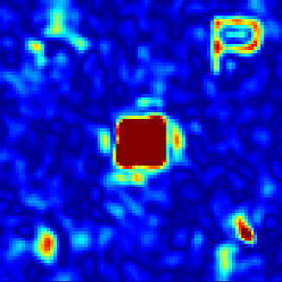


HBT for 3D Holography: Realization
CCD (BITRAN BU-42L-14)
He-Ne Laser
HWP1
M
O
HWP2
L1
S
L2
Ground glass
L3
SLM
PBS
CCD
f1=200mm
f1=200mm
f2=300mm
f2=300mm
f3=500mm
f3=500mm
SLM (HoloEye LC-R1080)
CCD image
D. N. Naik, et al , Opt. Express 19 (2011) 1408

Slide 20


Single pixel correlation holography
R. K. Singh, Opt. Lett 42 (2017)2515

Slide 21



Optical Channel
PC
M
SLM(reflection)
BS
P
T
D
Optical Propagation Channel
Io(u₁)
L
S
Bucket detection
R. K. Singh, Opt. Lett 42 (2017)2515

Slide 22
Digital Channel
Source plane (z=0)
Ic(u₂)
z
M
-z1
z2
Angular spectrum approach
R. K. Singh, Opt. Lett 42 (2017)2515

Slide 23

3D reconstruction results
Fig. Reconstructed images at three different depths from focal plane
R. K. Singh, Hybrid correlation holography with a single pixel detector. Opt. Lett 42 (2017)2515

Slide 24

Phase recovery with the HBT
$$C(∆r)={\left|W_{H}\left(Δr\right)+W_{R}(Δr)\right|}^{2}$$

Slide 25


Phase recovery & imaging with the HBT
R. K. Singh, et.al, Appl. Phys. Lett. 104 (2014) 111108

Slide 26








Quantitative imaging through scatterer
Imaging of object with helical phase structure
Imaging of star object
R. K. Singh, et.al. , Opt. Lett. 39 (2014) 5054

Slide 27
Phase shifting HBT holography
Li Chen, et.al., Opt. Lett.45 (2020) 212

Slide 28


Phase recovery in Ghost diffraction
Vinu, et.al, Optica 7 (2020) 1797

Slide 29
Ghost diffraction & phase recovery
Phase recovery:
Iterations based approach
Non interferometric
Manisha, et al; Opt. Commun 528 (2022) 129002

Slide 30
Stokes correlations:

Slide 31



Polarization of light
They were defined by George Gabriel Stokes in 1852.
S₀=|E_{x}²|+|E_{y}²| (Total Intensity)
S₁=|E_{x}²|-|E_{y}²| (Horizontal and vertical polarization)
S₂=2E_{x}E_{y}cosδ (Diagonal Polarization)
S₃=2E_{x}E_{y}sinδ (Circular Polarization)
Polarization
Rotating retarder
Linear polarizer
Detector

Slide 32



Pilot assisted configurations
Tushar Sarkar, et.al. Phys. Rev. A 104 (2021) 013525
Polarization speckle

Slide 33

Pilot assisted configuration: theory
$E(\hat{r}$)=$A_{l}(\hat{r)} e^{ilφ }e_{x}+A_{0}(\hat{r)} e_{y}$
$$E\left(r\right)=\int{E(\hat{r)}} H\left(r,\hat{r}\right) d\hat{r}$$
The correlation between SPs fluctuations is
The complex polarization correlation function is evaluated as
Tushar Sarkar, et.al. Phys. Rev. A 104 (2021) 013525

Slide 34



Experiment & Results
Tushar Sarkar, et.al. Phys. Rev. A 104 (2021) 013525
20

Slide 35





Stokes correlation : Results
Simulation & Experimental Results

Slide 36


Experiment:
Simulation
Experiment
l=-0.5
l=-0.5
l=0.5
l=0.5
l=1.5
l=1.5
Amplitude and Phase distributions
OAM distributions
Experimental measured Stokes parameters for l=-0.5
Tushar Sarkar, et.al., Opt. Laser in Eng. 155 (2022) 107065

Slide 37

Holography with Stokes correlation
Recording of Hologram
Reconstruction of Hologram
Tushar Sarkar, et.al. Phys. Rev. A 106 (2022) 013508

Slide 38


Holography with Stokes correlation
The correlation between SPs fluctuations is
$$\left(\begin{matrix}C_{00}(Δr) & C_{01}(Δr) & C_{02}(Δr) & C_{03}(Δr) \\ C_{10}(Δr) & C_{11}(Δr) & C_{12}(Δr) & C_{13}(Δr) \\ C_{20}(Δr) & C_{21}(Δr) & C_{22}(Δr) & C_{23}(Δr) \\ C_{30}(Δr) & C_{31}(Δr) & C_{32}(Δr) & C_{33}(Δr)\end{matrix}\right)$$
Using un-polarized source: W_{xy}(∆r) W_{yx}*(∆r)=0
$C_{22}(Δr)=\operatorname{Re}{[}W_{xx}(Δr)W_{yy}^{∗}(Δr$]
$C_{32}\left(∆r\right)=$ $i\operatorname{Im}{[}W_{xx}(Δr)W_{yy}^{∗}(Δr)]$
$$C(Δr)=C_{22}(Δr)+iC_{32}\left(∆r\right)$$
Tushar Sarkar,Phys. Rev. A 106 (2022) 013508

Slide 39





Holography with Stokes correlation
Amplitude
Phase
Experimental measured Stokes parameters :(a)-(b) for l=1, (c)-(d) for number 2
Simulation Results
Experimental Results
Phys. Rev. A 106 (2022) 013508
46

Slide 40

Speckle field digital polarization holographic microscope
Vinu R V, et al, Opt. Let. 44 (2019) 5711

Slide 41

Spatial resolution enhancement
MO=5X & 0.1NA
Vinu R V, et al, Opt. Let. 44 (2019) 5711

Slide 42
Conclusion:
Issue of imaging through/with randomness is discussed
Randomness of the light can be used to design and develop new and un-conventional imaging systems
Some of our contributions in this area are covered
Role of randomness assisted imaging and technologies are highlighted for different applications

Slide 43





Acknowledgement
CORE/2019/000026
BT/PR35557/MED/707/2019
080(0092)/2020/EMR-II
58/14/0/2021-BRNS/37092
Dr. Vinu R V & Dr. Darshika Singh, IIST-Trivandrum
Master students: Niraj Soni, Atul Somukuwar, Annie Varghese, Sreelal M,

Slide 44


