Slide 1
Correlation Imaging:
Seeing the invisible through the speckle grains
Rakesh Kumar Singh
Laboratory of Information Photonics & Metrology, Department of Physics, Indian Institute of Technology (Banaras Hindu University), Varanasi, Uttar Pradesh, 221005, India
krakeshsingh.phy@iitbhu.ac.in
SCOP 2022: 7th Student conference on Optics and Photonics: PRL, 28-30 Sept 2022

Slide 2
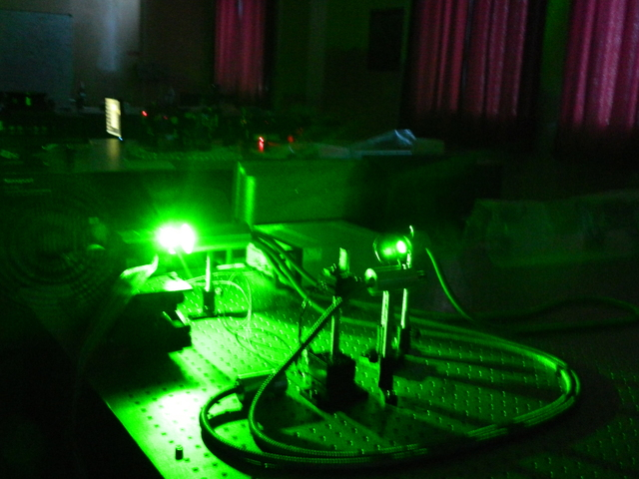
Outline of talk
Light
Uniform
Random
Speckle grains
Seeing through randomness
Countering and cancelling the randomness
Randomness assistedmethods
Some experimental designs
Applications
Conclusion

Slide 3
Light fields
Amplitude
Phase
Correlations
Single point (polarization) and Two point correlations
Light: temporally and spatially confined in phase space (source: Takeda et al , Opt. Rev. 21 (2014) 849)

Slide 4

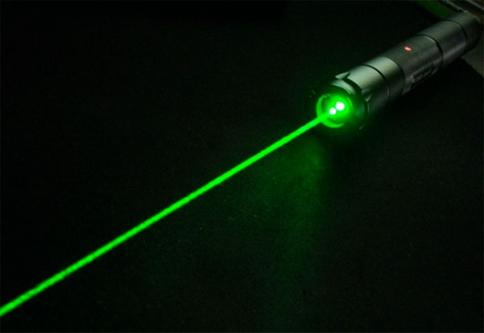
Seeing and Imaging
Propagation induced effects
Filtering
Information processing

Slide 5
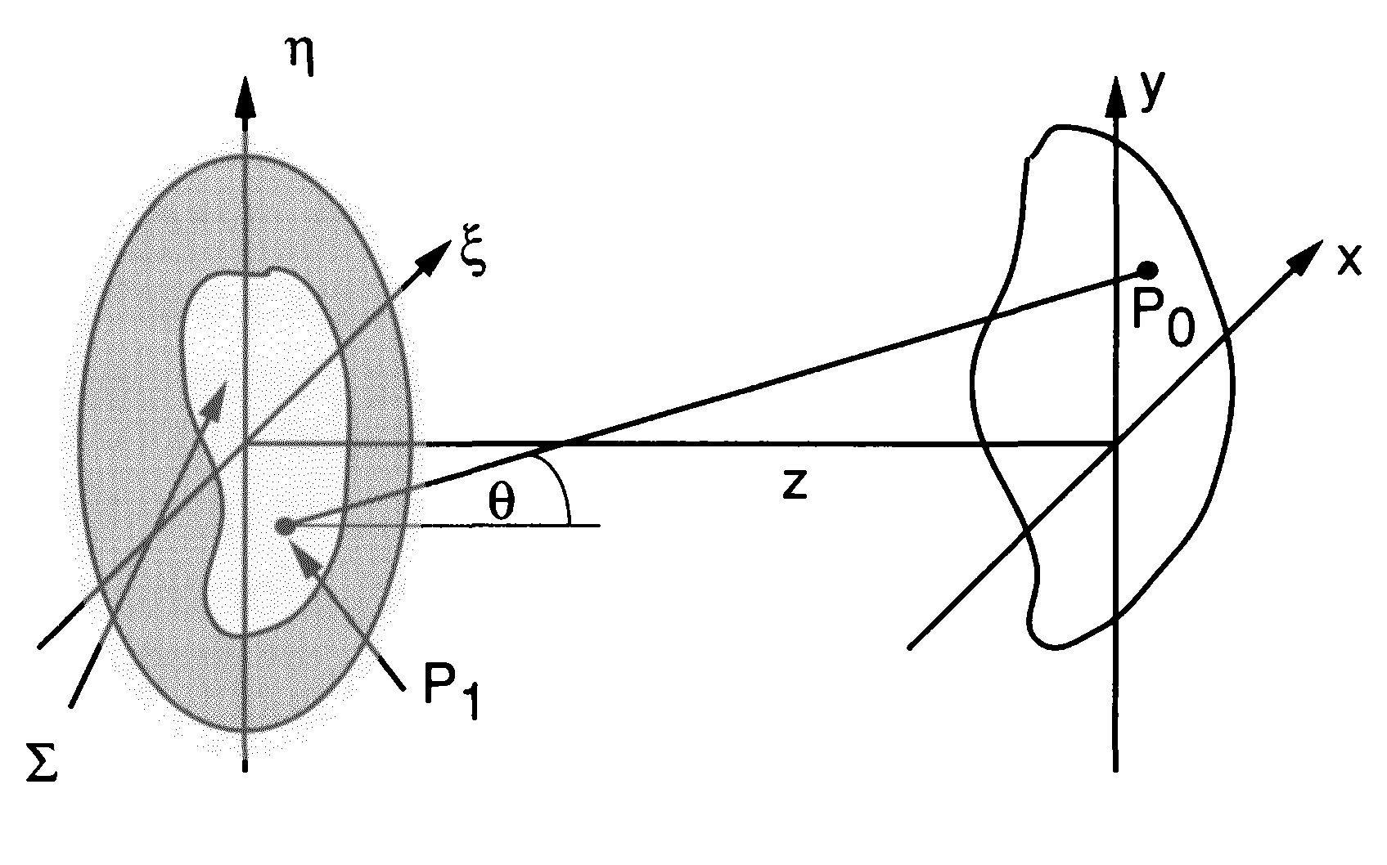
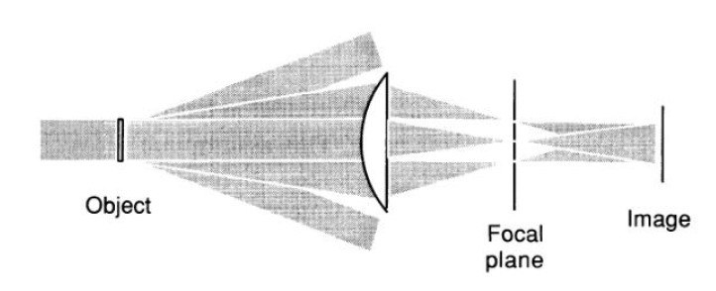


Imaging: Basic principle
Resolution: is limited by diffraction
J. Goodman, Fourier Optics

Slide 6
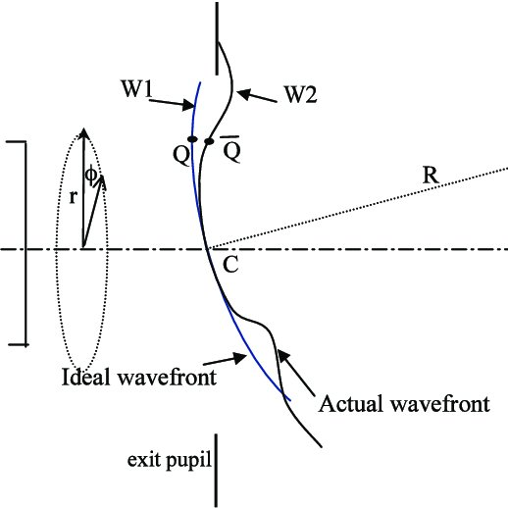
Resolution limit
Airy disc
Point spread function is:
Resolution limit:

Slide 7
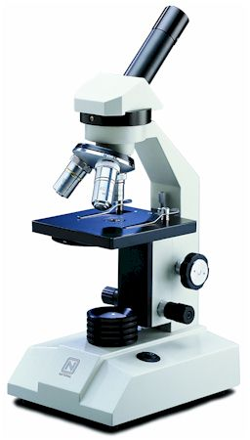
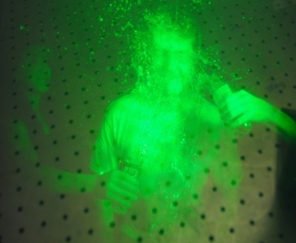
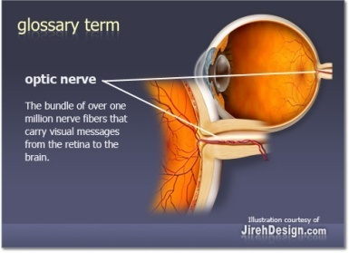
Optical Imaging
An Imaging Lens
Microscopy: desired to get higher resolution
Holography: Provides 3D complex field reconstruction
optical coherence (OCT) tomography (for sectional imaging)
2f
2f
Imaging lens

Slide 8
Seeing the obscured:

Slide 10
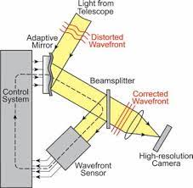
Measurement and Cancellation of randomness
Ref. A. T. Tokunaga, Advanced in Adaptive Optics , Encyclopedia of the Solar System (3nd Ed, 2014)

Slide 11
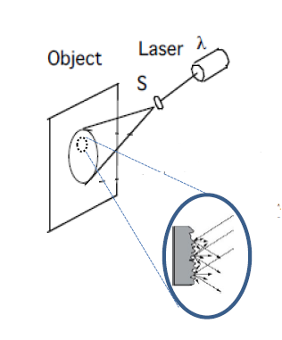
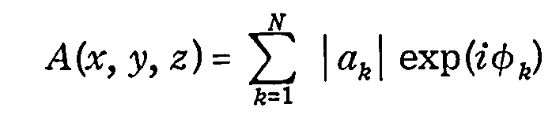
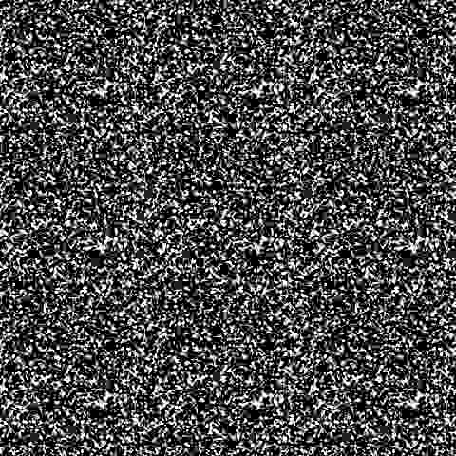
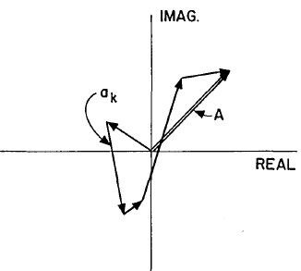
Laser speckle
Ref. P. S. Idell, J. R. Fienup and R. S. Goodman, Opt. Lett. 12 (1987) 858 & J. W. Goodman, Laser speckle and applications

Slide 12
Seeing inside the speckle grains
Ref. Y. Choi, W. Kim, C. Park, J. Park, Y. K. Park, and Y. Cho, Wide-field super-resolution optical fluctuation imaging through dynamic near-field speckle illumination” Nano Lett 22 (2022) 2194

Slide 13
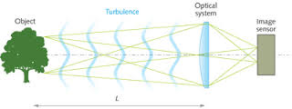
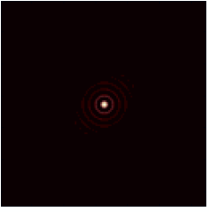
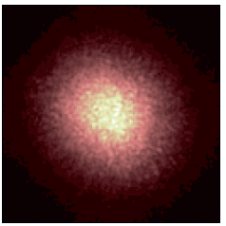
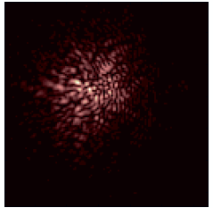
Optical Imaging through randomness
(temporal fluctuations)
Atmospheric perturbed PSF observed at the focus of a large ground based telescope. Left to right –ideal PSF, long exposure PSF, short exposure PSF
Ref. M. Carbillet, New Concepts in imaging: optical and statistical models, EAS 2013

Slide 14
Image in presence of speckle
Ref. A. Labeyrie, Aston. & Astophys. 6 (1970) 85

Slide 15
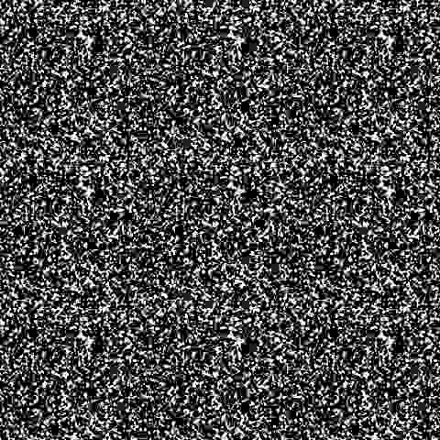
Recovery of Fourier spectrum
Speckle snap shots
Phase information is lost
Therefore, only size of the object can be estimated
Ref. A. Labeyrie, Aston. & Astophys. 6 (1970) 85

Slide 16
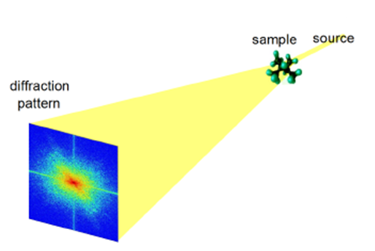
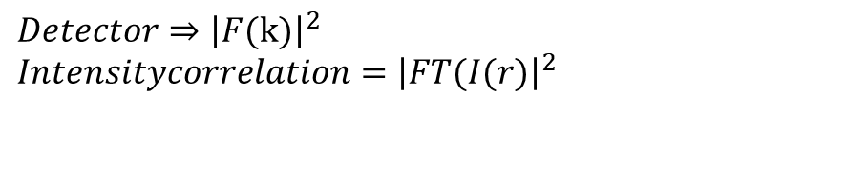
Phase Recovery challenge
$$Detector⇒{\left|F(k)\right|}^{2} \\ Intensitycorrelation={\left|FT(I(r)\right|}^{2}$$
Recovery of phase:
Iterations
Interferometric approach
Highly stable imaging systems with the HBT approach:
Phase shifting holography with HBT method- Opt. Letter 45 (2020) 212; Opt. Express 28 (2020) 8145
HBT with polarized light: Opt. Express 26 (2018) 10801
Opt. Laser in Eng. 148 (2022) 106771

Slide 17
Looking inside speckle grains

Slide 18
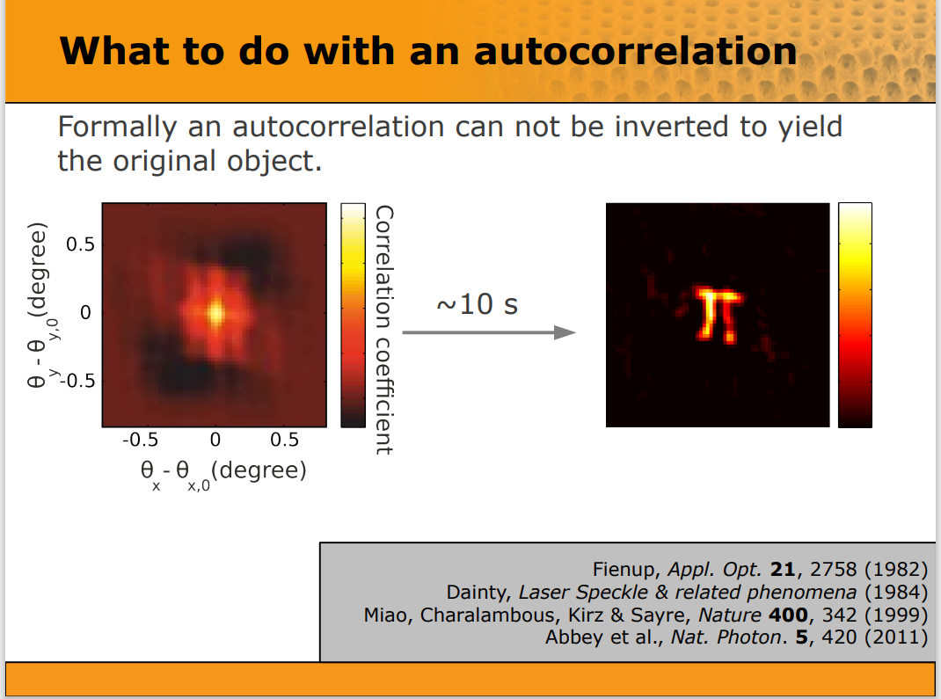
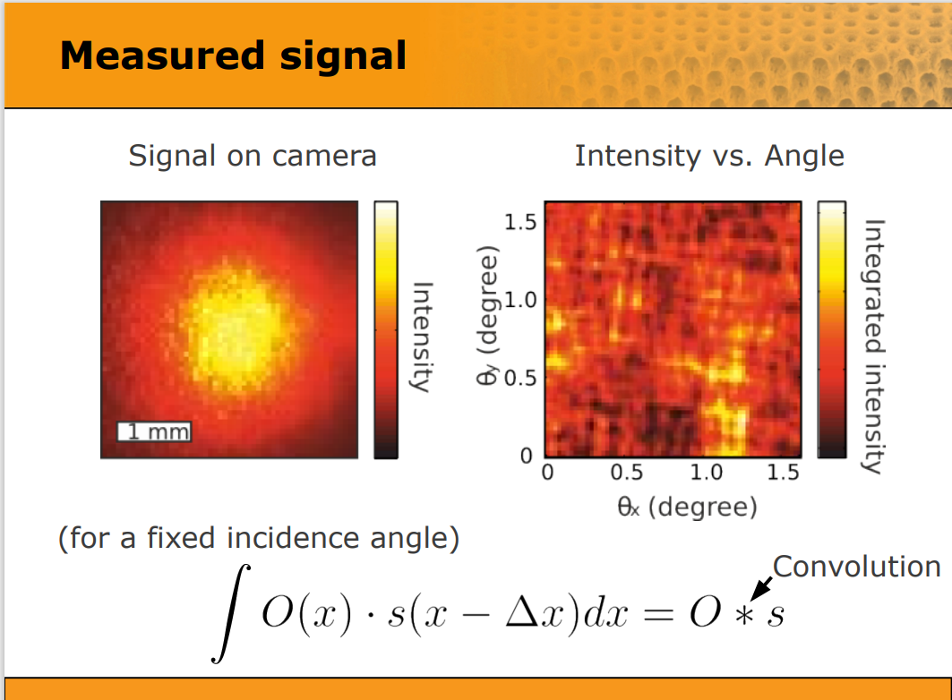
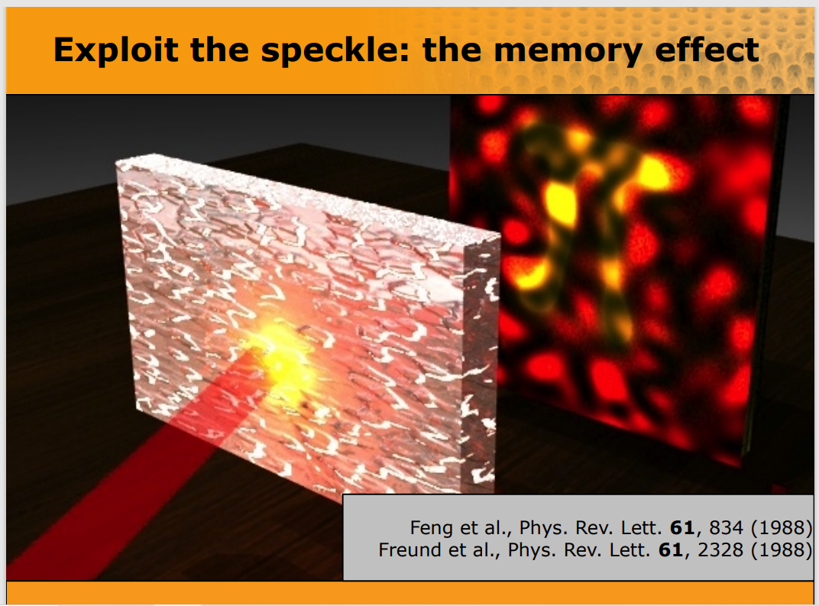
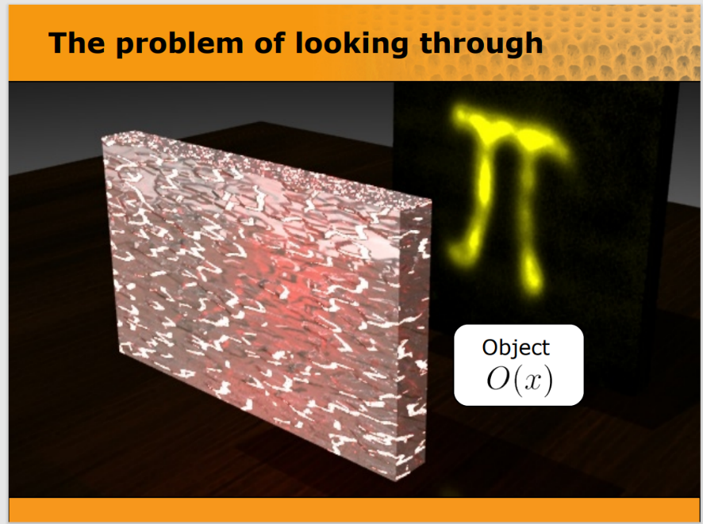
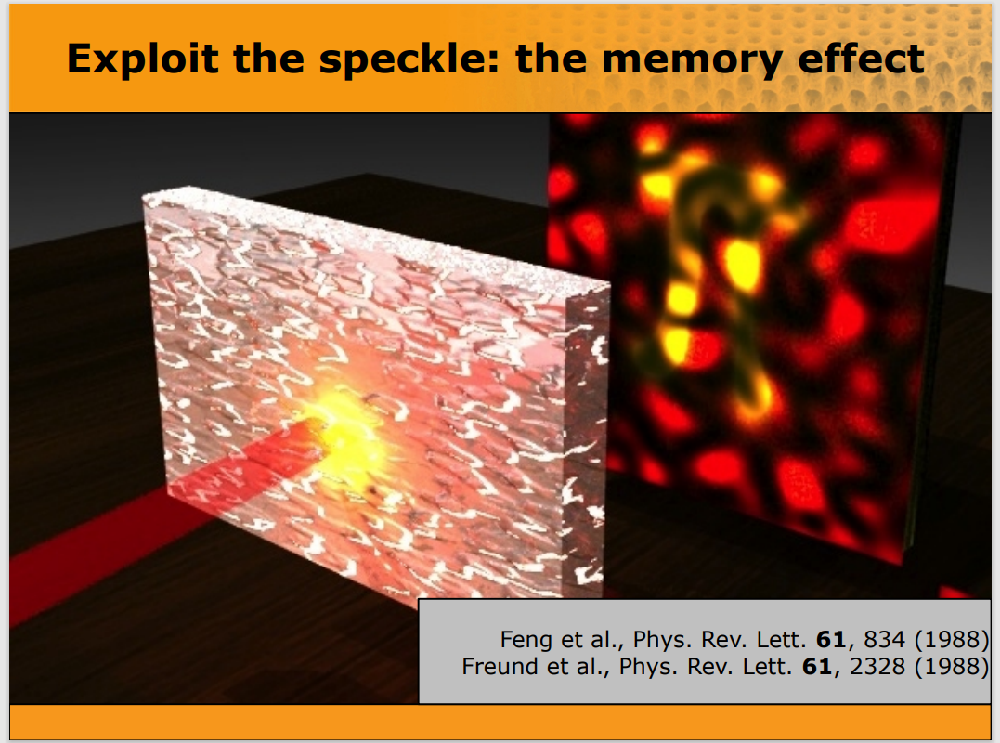
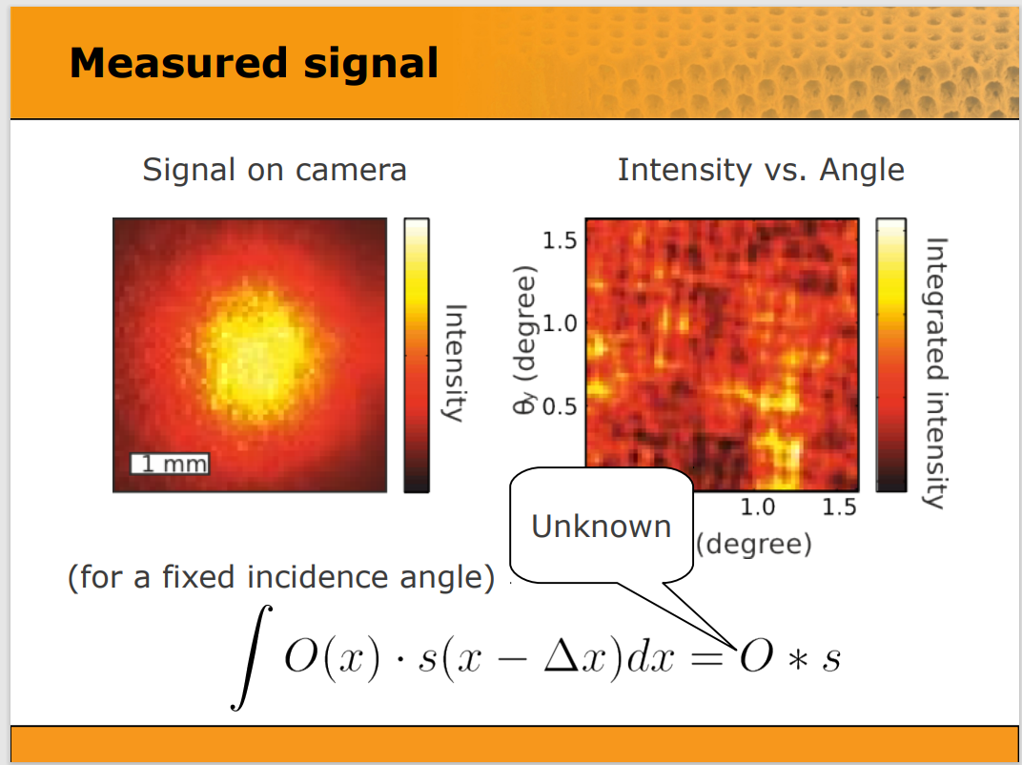

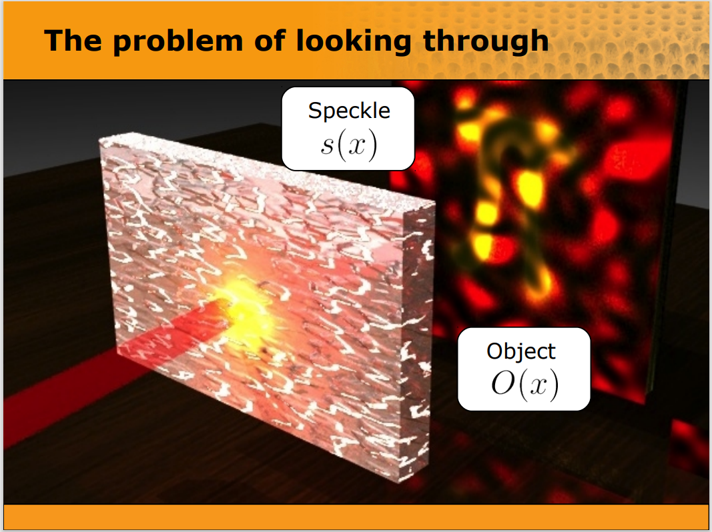
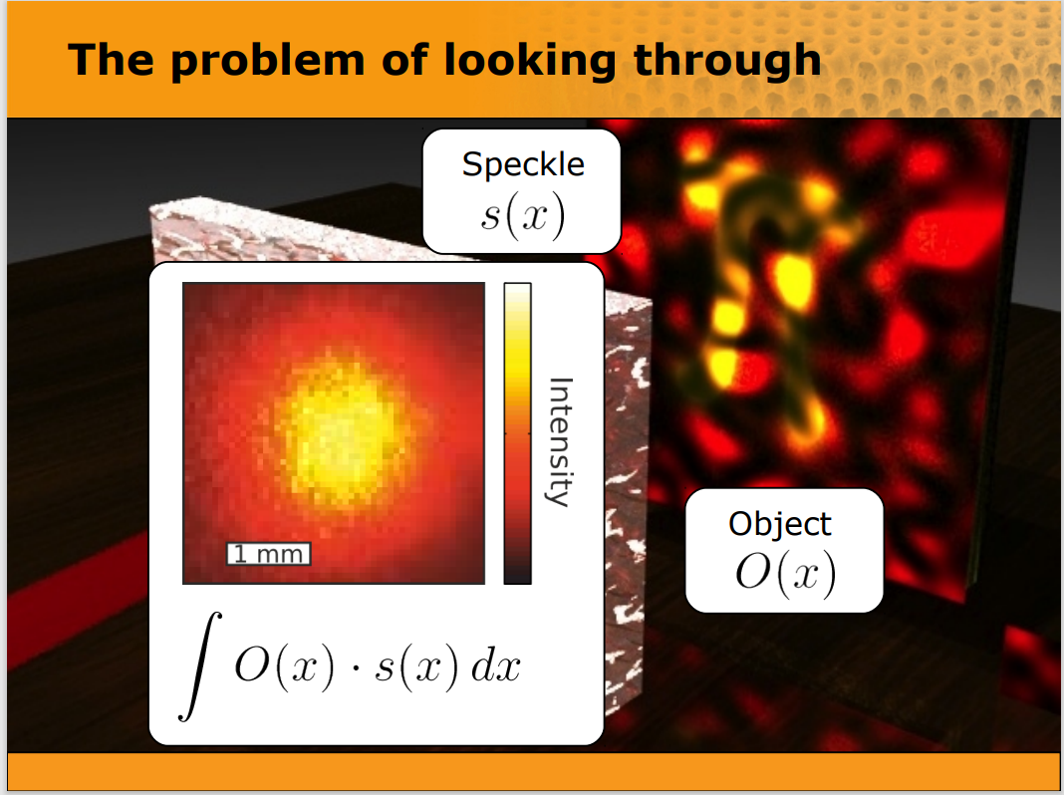
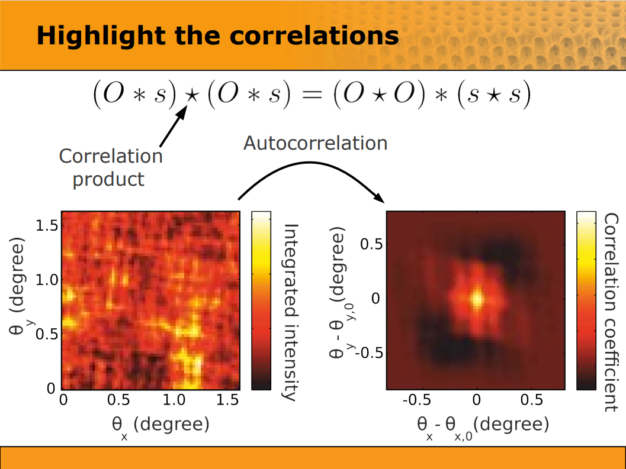
Speckle grain & autocorrelation

Slide 19
Holography with laser speckle:
For Non-iterative Phase recovery

Slide 20
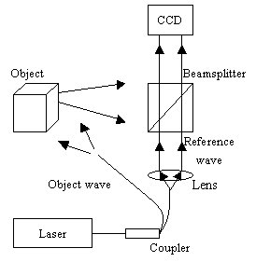
Digital Holography
Optical recording & Digital reconstruction
Non-mechanical 3D Imaging possible

Slide 21
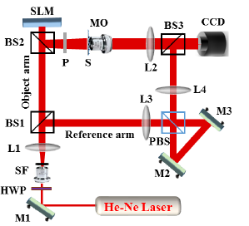
Speckle assisted digital holography
Optics Letter 44 (2019) 5711

Slide 22
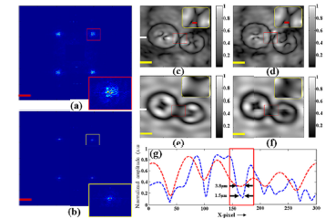
Enhanced resolution in speckle assisted DHM
MO=5X & 0.1NA
Optics Letter 44 (2019) 5711

Slide 23
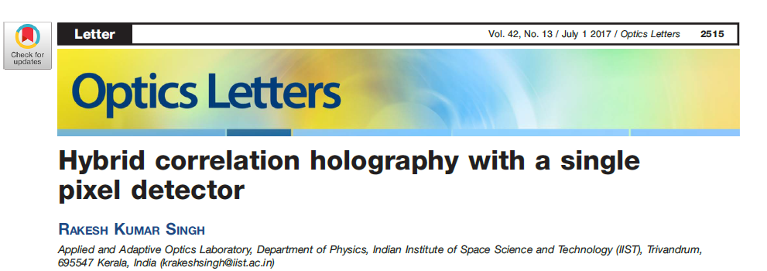
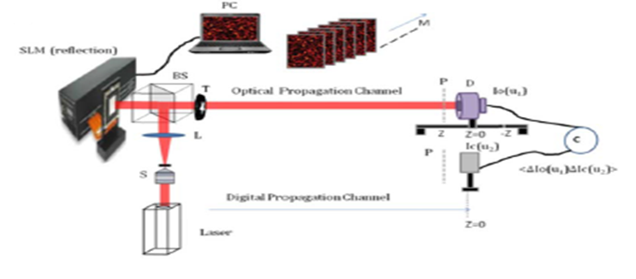
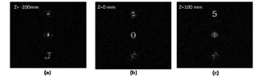
Speckle assisted imaging: Single pixel holography

Slide 24
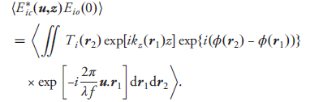


Correlation structure
For incoherent source illumination
Opt. Lett. 42 (2017) 2515

Slide 25
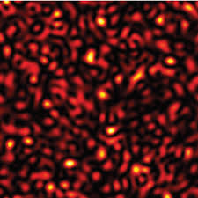
Digital Channel
Source plane (z=0)
Ic(u₂)
z
M
-z1
z2
Angular spectrum approach

Slide 26
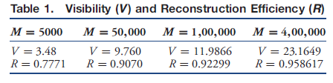
3D reconstruction results
Fig. Reconstructed images at three different depths from focal plane
Opt. Lett. 42 (2017) 2515

Slide 27
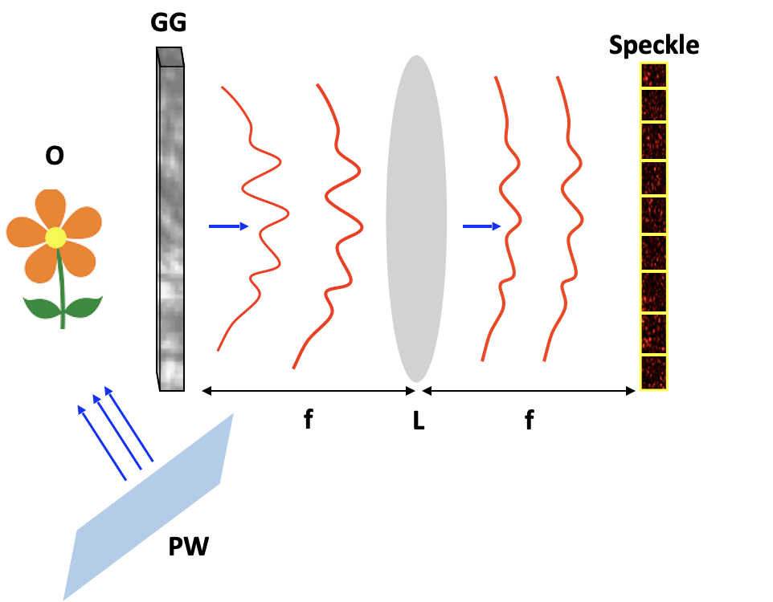
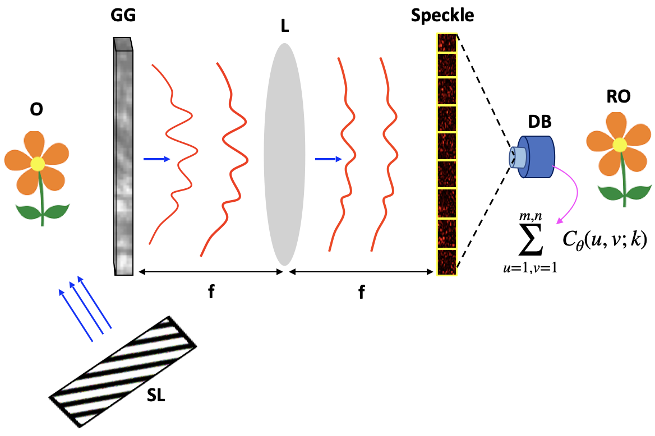
STICH:
Structured light illumination correlation holography
A. C. Mandal, T. Sarkar, Z. Zalevsky, and R. K. Singh, Structured transmittance illumination correlation holography, Scientific Rep. 12 (2022) 4564

Slide 28
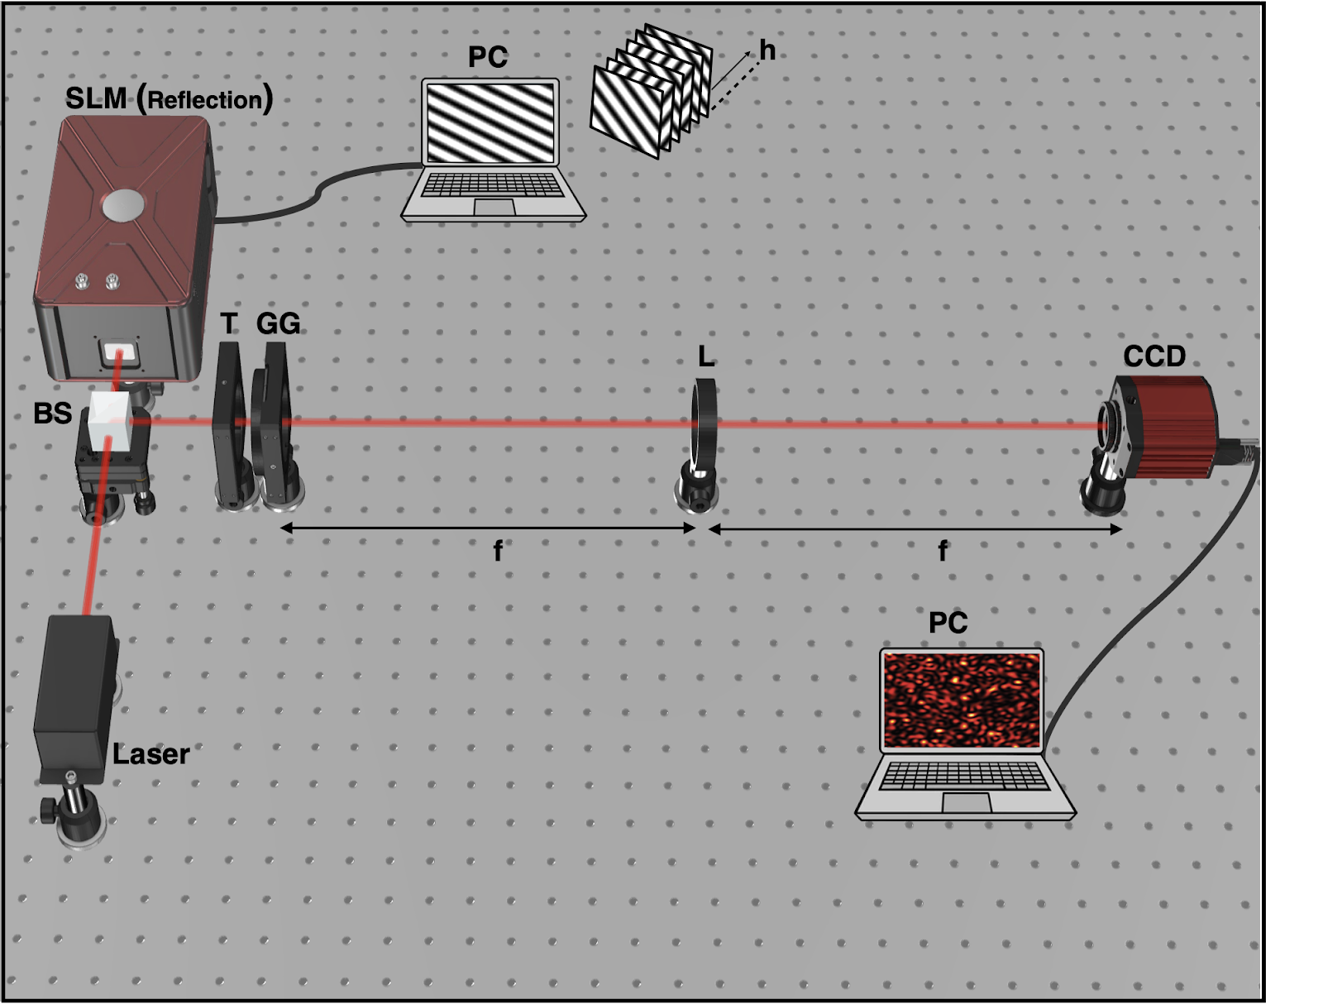
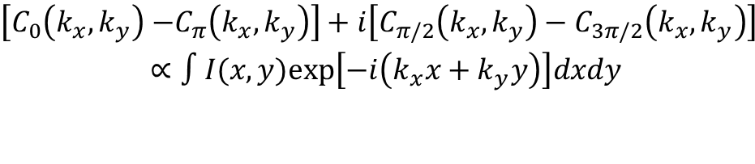
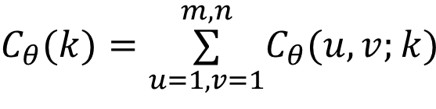
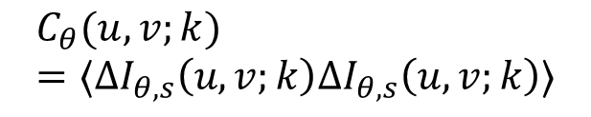
Stich:
$$C_{θ}(u,v;k)=⟨ΔI_{θ,s}\left(u,v;k\right)ΔI_{θ,s}\left(u,v;k\right)⟩$$
$$C_{θ}(k)=\overset{m,n}{\underset{u=1,v=1}{∑}}C_{θ}(u,v;k)$$
$$\begin{aligned}\left[C_{0}\left(k_{x},k_{y}\right)\right. \left.−C_{π}\left(k_{x},k_{y}\right)\right]+i\left[C_{π/2}\left(k_{x},k_{y}\right)−C_{3π/2}\left(k_{x},k_{y}\right)\right] \\ ∝∫I(x,y)exp⁡\left[−i\left(k_{x}x+k_{y}y\right)\right]dxdy\end{aligned}$$
A. C. Mandal, T. Sarkar, Z. Zalevsky, and R. K. Singh, Structured transmittance illumination correlation holography, Scientific Rep. 12 (2022) 4564

Slide 29
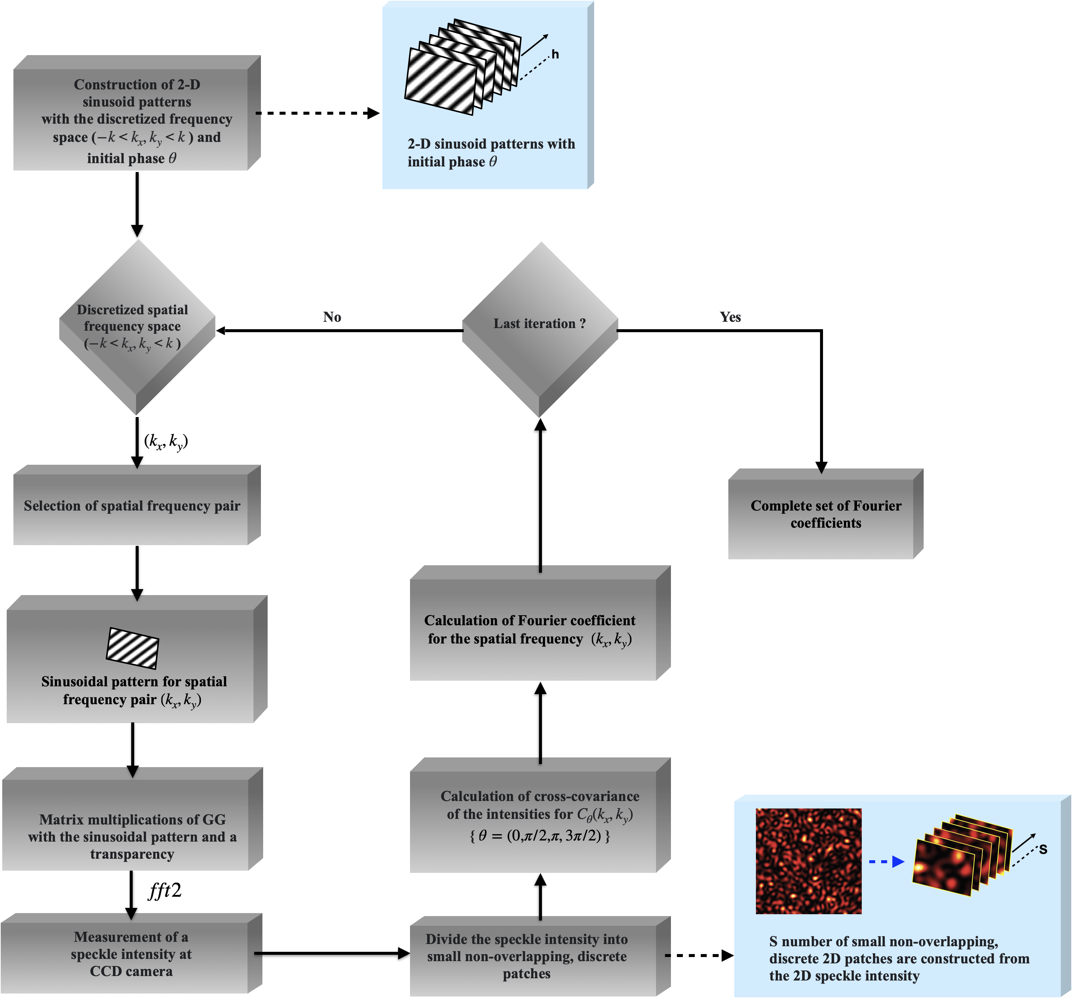
Protocol: Structured light …
A. C. Mandal, T. Sarkar, Z. Zalevsky, and R. K. Singh, Structured transmittance illumination correlation holography, Scientific Rep. 12 (2022) 4564

Slide 30
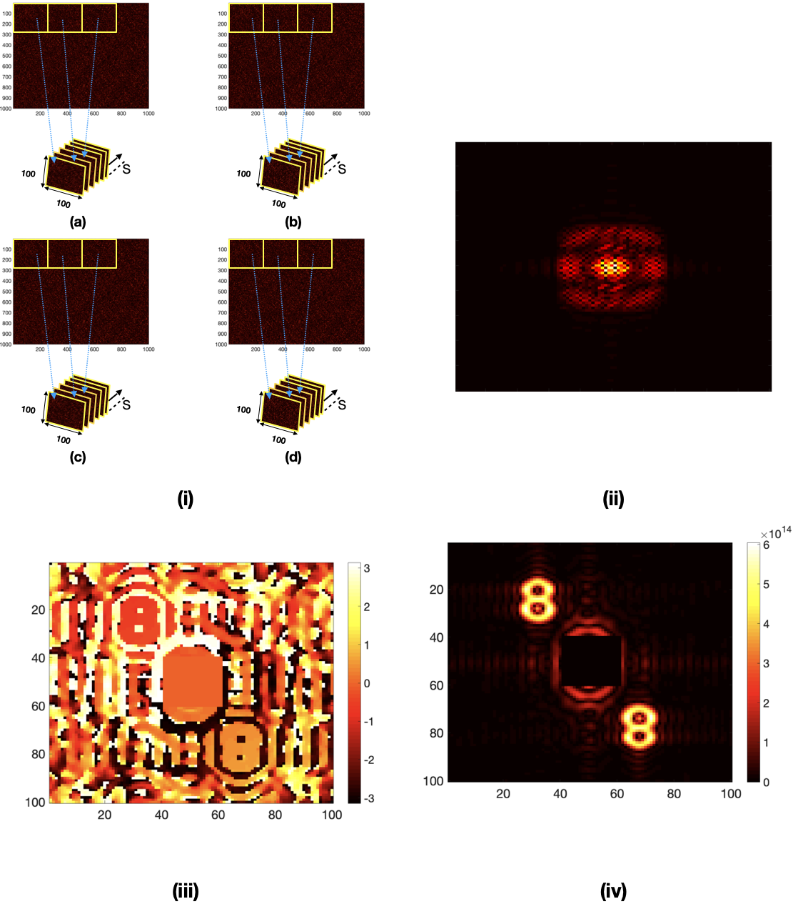
Results: Stich
A. C. Mandal, T. Sarkar, Z. Zalevsky, and R. K. Singh, Structured transmittance illumination correlation holography, Scientific Rep. 12 (2022) 4564

Slide 31
Conclusion:
Issue of imaging through/with randomness is discussed
Randomness of the light can be used to design and develop new and un-conventional imaging systems
Some of our contributions in this area are covered
Role of randomness assisted imaging and technologies are highlighted for different applications

Slide 32


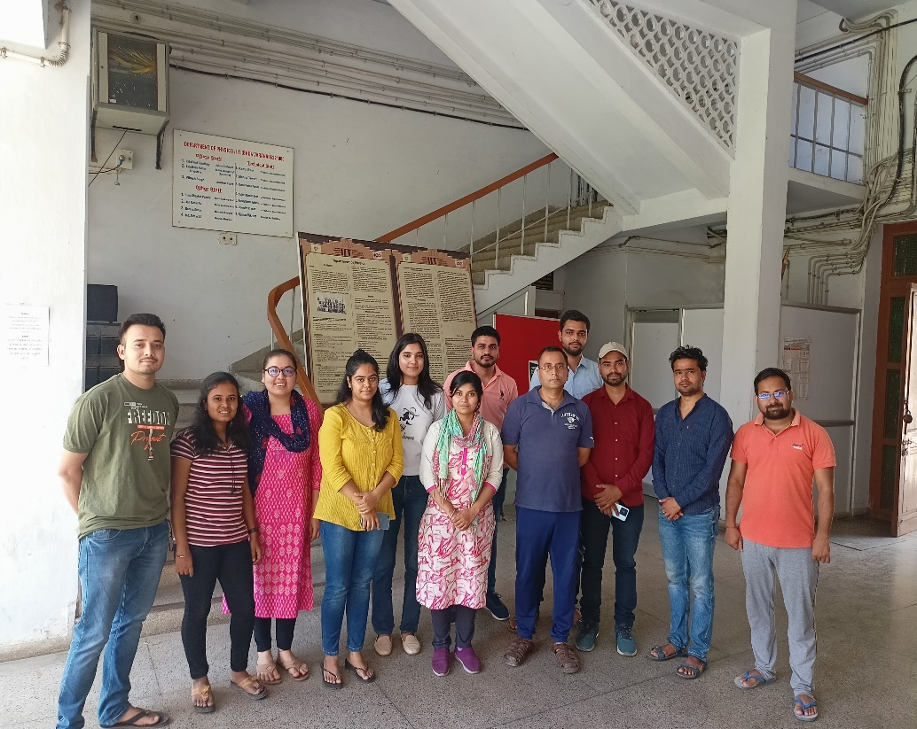


Acknowledgement
CORE/2019/000026
BT/PR35557/MED/707/2019
58/14/0/2021-BRNS/37092
Dr. Vinu R V & Dr. Darshika Singh, IIST-Trivandrum
Master students: Niraj Soni, Atul Somukuwar, Annie Varghese, Sreelal M,

Slide 33


